Slide 1

North American Heavy Rare Earth Supply Chain
GE Chaplin Inc.
Melvin Hill

Slide 2
Disclaimer
All statements in this analysis, other than statements of historical facts, that address future market developments, government actions and events, are forward-looking statements. GE Chaplin Inc. believes that outcomes in such forward-looking statements are based on fair expectations and assumptions but are not a guarantee of future performance. Actual results may differ from forward looking statements due to shifts in government policy, the development of new rare earth technologies or substitutes, or other changes in economic conditions. This report, authorized by GE Chaplin Inc., is not intended to be used as investment advice. GE Chaplin Inc. will not be held liable for any loss as a result of investments in the rare earth industry, including, but not limited to, commodities and publicly traded shares. Parties interested in investing in the rare earth industry should seek the advice of an experienced professional. The reader of this document assumes all responsibility of this market material and information.

Slide 3
Summary Of Presentation
Why skip light rare earths?
Demand Overview
Supply Overview
Government Initiatives
Conclusions
GE Chaplin Introduction

Slide 4
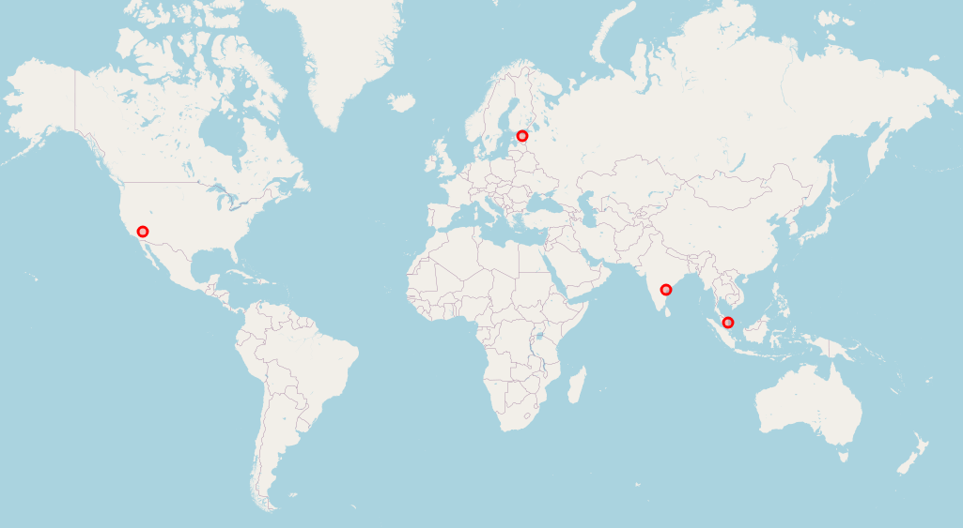

Why skip light Rare Earths?
Established Producers
Sufficient Production Capacity
Competitive Pricing

Slide 5
Why Skip Light Rare Earths?

Slide 6
Demand Overview
Import Data Methodology
Pulled from maritime import database.
HS codes 2805.30, 2846.90.
Cross referenced with B/L search for all individual RE oxide + Metals.
Cross referenced with AM Export data.
Adjusted for TREO using standard industry specifications.

Slide 7
Demand Overview
By Value

Slide 8
Demand Overview
Lutetium

Slide 9
Demand Overview
Gadolinium

Slide 10
Demand Overview
Terbium + Dysprosium

Slide 11
Demand Overview
Yttrium

Slide 12
Demand Overview
Other Heavies

Slide 13





North American Production Overview:
Key Sections
Primary Ore/Concentrate
Separation/Pure REOs
Metallization
Recycling
Permanent Magnet

Slide 14
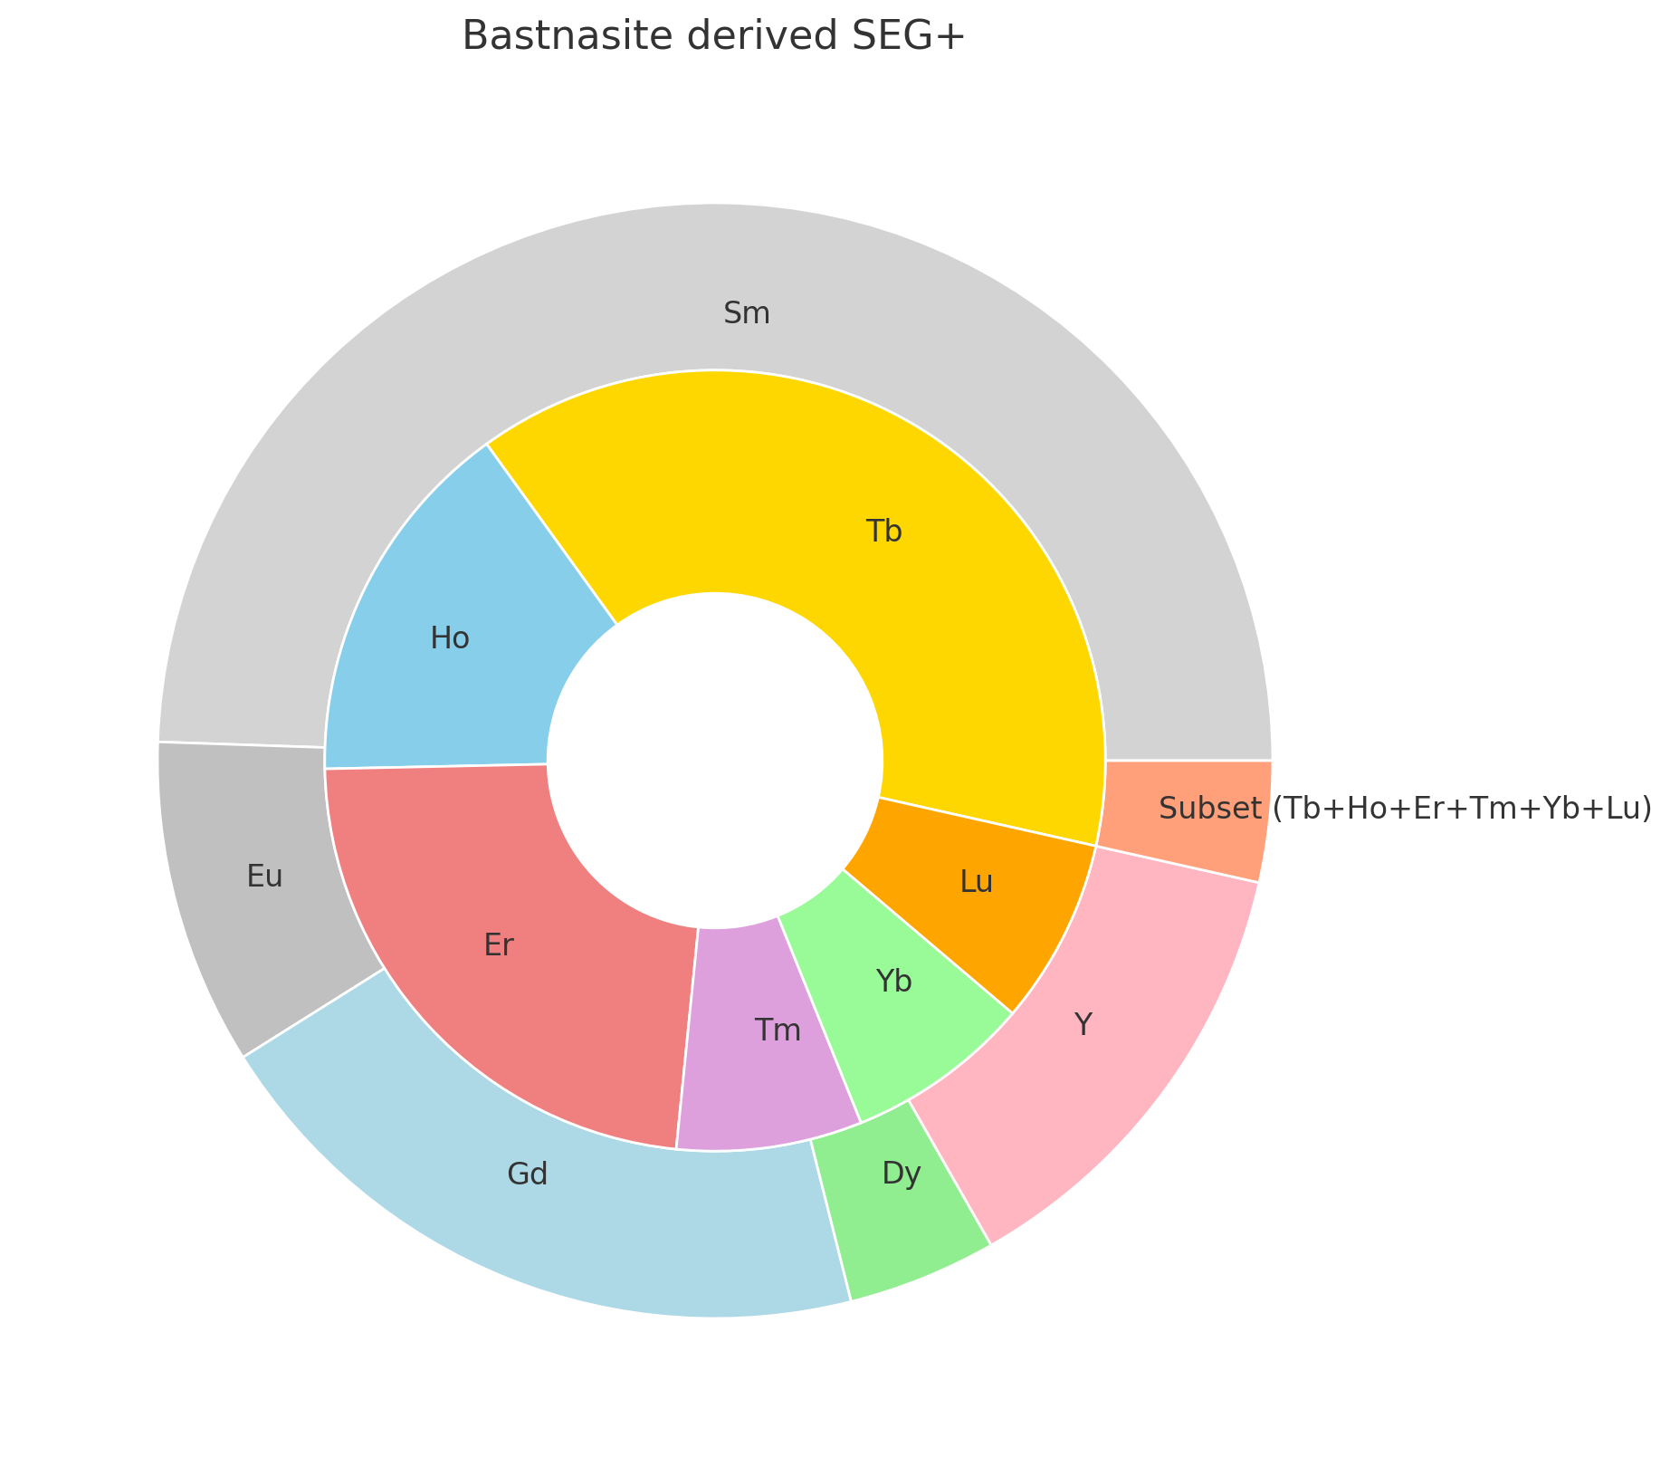
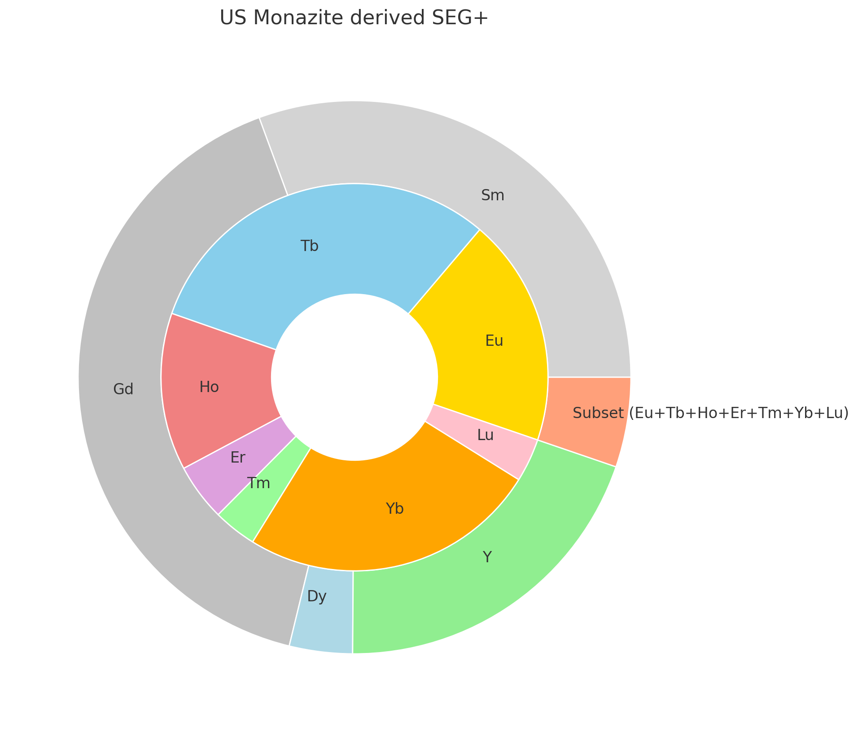















Supply Overview:
Primary Ore/Concentrate
Bastnasite, Monazite → SEG+
  <200MT
Notes:
Focus on MP SEG.

Slide 15










Supply Overview:
Recycling
Permanent Magnet Recycling Efforts
Other RE Bearing Scrap Recycling Efforts
  CFL
  Ceramic Coatings
  Spent Catalyst
  Other

Slide 16








Supply Overview
Separation
VERY Small scale HREO production (<50MT)
HRE refining capacity by 2028 may exceed 5,500MT
Emphasis on Dy+Tb, most will not separate balance heavies
Operational 1-2 years 2-3 year
Notes:
MP Production Update
Rare Earth Salts Production Update

Slide 17






Supply Overview
Metallization
Electrolytic Production: Commercial Scale Operational (DyFe)
Vacuum Induction: Small scale production operational (Sm, Dy, Tb).
Novel Techniques: Operational at pilot scale
High Purity REMs (Sublimed): R&D stage
Notes:
Include USA Rare Earths, MP Materials production in Canada, Magnesium Guys

Slide 18







North American Production Overview
Permanent Magnet
Notes:
Include Vulcan Materials, POSCO

Slide 19

US Government Initiatives
Funding
DOGE
DOD: ~$439 million awarded
DOE: >$290 million awarded
EXIM: LOIs for loans, ~1.5 billion
State-Level: TX, OK, MA, NE, WY, + many more…
DARPA: EMBER, SPREE
DLA: Stockpiling Program

Slide 20
Government Initiatives
Policy
2024 Biden Administration
DFARS Case 2018-D054
PM Tax Credit (IRA)
DFARS 252.225-7001 (Buy American)
“Fact Sheet: President Donald J. Trump Takes Immediate Action to Increase American Mineral Production” - March 20th, 2025
“Ensuring National Security and Economic Resilience Through Section 232 Actions on Processed Critical Minerals and Derivative Products” – April 15th, 2025
“Unleashing America’s Offshore Critical Minerals and Resources” – April 24th, 2025

Slide 21
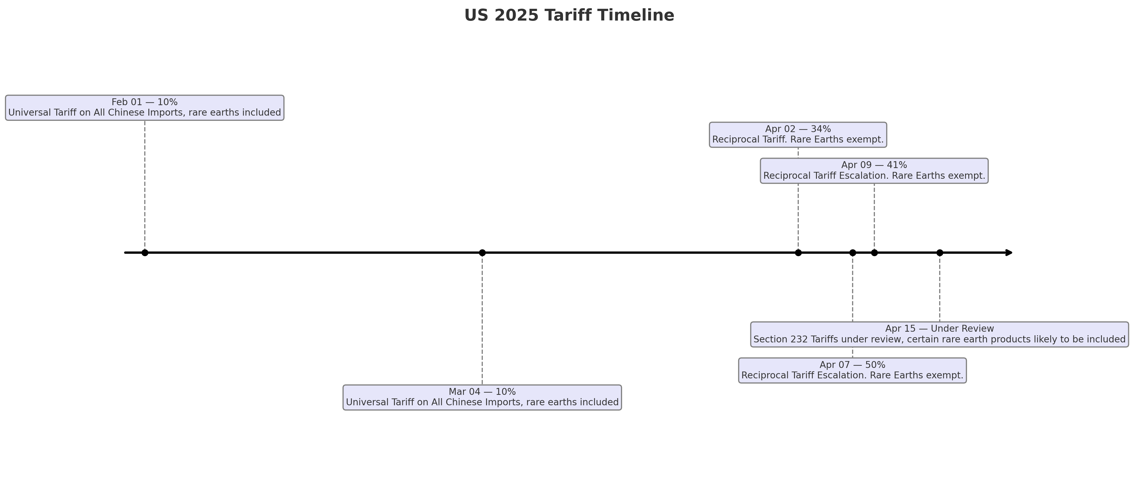
Government Initiatives
Policy
“Critical minerals, including rare earth elements, in the form of processed minerals are essential raw materials and critical production inputs required for economic and national security.”
- April 15, 2025, Executive Order

Slide 22
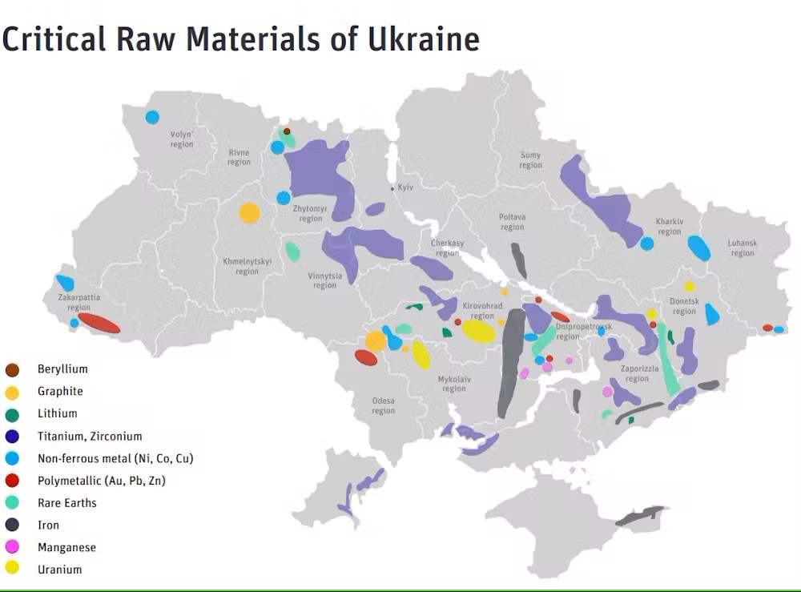
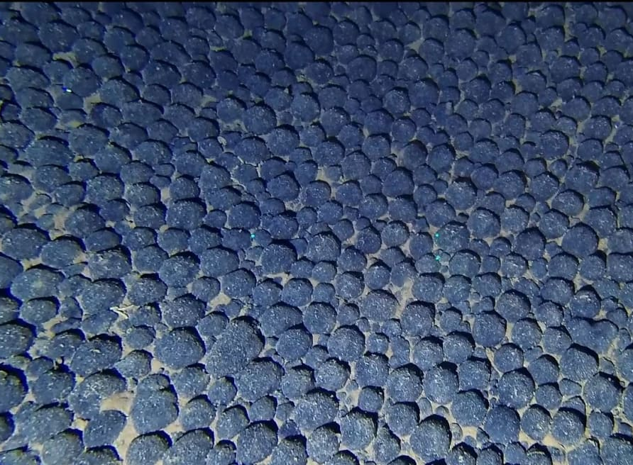
Government Initiatives
Other Policy Considerations
Accelerated Permitting.
Access to Federal Lands.
Loan/Financing support.
Encourage establishment of critical mineral sector specific public/private joint ventures

Slide 23
Conclusions
Demand
Driven by Lu, Gd, Y, and Tb.
Tb + Dy demand to increase significantly with PM production ramp up.
Supply
Advancing but still far from self-sufficiency.
Major bottlenecks are upstream (feedstock, separation).
Public Initiatives
Shift away from direct spending towards support through policy.
Protecting an industry that does not exist.

Slide 24

Introduction: G.E. Chaplin, Inc. Background
Headquartered in Flemington, NJ.
2nd Generation family-owned company.
Established in 1988 as a manufacturer’s representative/sales agency servicing the paint, ink, plastics, and catalyst industries.
Entered the rare earth sector in 2001, primarily focused on US and European markets.
Established European office, GE Chaplin BV, in 2019, REACH registered for multiple rare earth products.

Slide 25
Thank you!

